Slide 1



Computer Assisted Natural Language Description of Trends and Patterns in Time Series Data
Master Thesis - Final Presentation
Siddhesh Kandarkar
Advisor: Daniel Braun
02.11.2020, München
Chair of Software Engineering for Business Information Systems (sebis) Faculty of Informatics
Technische Universität München wwwmatthes.in.tum.de

Slide 2

Partner
03694397, Siddhesh Kandarkar, Computer Assisted Natural Language Description of Trends and Patterns in Time Series Data

Slide 3
Outline
Motivation and problem
Research questions and approaches
Different approaches for writing executive summaries for time-series data
Requirement elicitation
Prototype implementation and evaluation
Limitations and Future work
Conclusion
03694397, Siddhesh Kandarkar, Computer Assisted Natural Language Description of Trends and Patterns in Time Series Data

Slide 4
Outline
Motivation and problem
Research questions and approaches
Different approaches for writing executive summaries for time-series data
Requirement elicitation
Prototype implementation and evaluation
Limitations and Future work
Conclusion
03694397, Siddhesh Kandarkar, Computer Assisted Natural Language Description of Trends and Patterns in Time Series Data

Slide 5






Motivation and problem
Celonis
Snap
Time-series KPI data
Data expert
Data-driven report
Business stakeholders
Time-series line chart and statistical data
03694397, Siddhesh Kandarkar, Computer Assisted Natural Language Description of Trends and Patterns in Time Series Data

Slide 6











Motivation and problem
Celonis
Snap
Time-series KPI data
Data expert
Data-driven report
Business stakeholders
Time-series line chart and statistical data
Static
03694397, Siddhesh Kandarkar, Computer Assisted Natural Language Description of Trends and Patterns in Time Series Data

Slide 7

Motivation and problem
Time-series line chart and statistical data
Automated Reporting assistant tool
Time-series KPI data
Data expert
Data-driven report
Business stakeholders
Textual executive summary
03694397, Siddhesh Kandarkar, Computer Assisted Natural Language Description of Trends and Patterns in Time Series Data

Slide 8
Outline
Motivation and problem
Research questions and approaches
Different approaches for writing executive summaries for time-series data
Requirement elicitation
Prototype implementation and evaluation
Limitations and Future work
Conclusion
03694397, Siddhesh Kandarkar, Computer Assisted Natural Language Description of Trends and Patterns in Time Series Data

Slide 9
Research questions and approaches
Research questions:
  RQ 1: What are the advantages and drawbacks with the current manual and automated approaches for writing textual executive summaries for time-series KPI data?
  RQ 2: Which are state-of-the-art NLG approaches in the literature and practice for data- to-text generation of time-series KPI data?
  RQ 3: Can an automated reporting assistant tool prove beneficial for the data experts in writing textual executive summaries for time-series KPI data?
03694397, Siddhesh Kandarkar, Computer Assisted Natural Language Description of Trends and Patterns in Time Series Data

Slide 10
Research questions and approaches
Research approach:
Conceptual approach | Practical approach
Literature review of existing manual and automated approaches of report writing for time-series KPI data | Requirement gathering
Literature review of NLG approaches for data-to-text generation of time-series KPI data | Defining design goals and architecture for developing a prototype for automating report writing process
 | Prototype development
 | Prototype evaluation
03694397, Siddhesh Kandarkar, Computer Assisted Natural Language Description of Trends and Patterns in Time Series Data

Slide 11
Outline
Motivation and problem
Research questions and approaches
Different approaches for writing executive summaries for time-series data
Requirement elicitation
Prototype implementation and evaluation
Limitations and Future work
Conclusion
03694397, Siddhesh Kandarkar, Computer Assisted Natural Language Description of Trends and Patterns in Time Series Data

Slide 12
Different approaches for writing executive summaries for time-series data
Manual approach
Automated approach
  Template-based systems
  NLG systems
    Rule-based systems
    Machine learning based systems
  Hybrid systems
03694397, Siddhesh Kandarkar, Computer Assisted Natural Language Description of Trends and Patterns in Time Series Data

Slide 13
Different approaches for writing executive summaries for time-series data
Manual approach
PROS (Less requirement for writing data-driven reports) | CONS (High requirement for writing data-driven reports)
Personalization Ease of use Ease of access Cost-effective | Tedious Repetitive Time-consuming Expensive Static reports
03694397, Siddhesh Kandarkar, Computer Assisted Natural Language Description of Trends and Patterns in Time Series Data

Slide 14
Different approaches for writing executive summaries for time-series data
2. Automated approach
PROS | HINDRANCES
Time-efficient Scalable Improves efficiency of data experts Reduce risk of statistical and grammatical errors Dynamic reports | Budget issues Lack of expertise Integration issues Trust issues
03694397, Siddhesh Kandarkar, Computer Assisted Natural Language Description of Trends and Patterns in Time Series Data

Slide 15
Findings – RQ1
RQ1 - What are the advantages and drawbacks with the current manual and automated approaches for writing textual executive summaries for time-series data?
  Issues with manual approach:
    Time consuming
    Repetitive
    Costly
    Static
  Automated approach:
Advantages | Drawbacks
Saves time Offers scalability Improves efficiency Cost effective Dynamic | Budget issues Lack of expertise Integration issues Trust issues
03694397, Siddhesh Kandarkar, Computer Assisted Natural Language Description of Trends and Patterns in Time Series Data

Slide 16
Findings – RQ2
RQ2 - Which are state-of-the-art NLG approaches in the literature and practice for data-to-text generation of time-series data?
Template based | Rule-based | Machine learning-based
Pre-defined templates Fill-in-the-gap approach | Add conditional checks and grammatical rules Generation patterns are coded manually | Fully data-driven NLG approach Generation patterns are learned from a training corpus
Easy to use and implement Cost-effective | Flexible More variations and better text quality Less time for development compared to ML-based | More adaptable to domain changes Best suited for complex data sets and multiple domain use-cases
Static Lack flexibility | Difficult to manage and implement when the data sets are huge and complex Cannot adapt to domain changes | Cost of preparing data and knowledge base is comparatively higher Text quality is lower compared to other approaches Time and effort required for implementation is much higher

Slide 17
Outline
Motivation and problem
Research questions and approaches
Different approaches for writing executive summaries for time-series data
Requirement elicitation
Prototype implementation and evaluation
Limitations and Future work
Conclusion
03694397, Siddhesh Kandarkar, Computer Assisted Natural Language Description of Trends and Patterns in Time Series Data

Slide 18
Requirement elicitation
It is the process of researching and discovering the requirements of a system from the business stakeholders.
Task-based approach was used for requirement elicitation
Steps involved in requirement elicitation process:
  Acquiring background knowledge
  Identifying stakeholders
  Creating a time-series dashboard in Celonis snap application
  Conducting task-based interviews with different stakeholders
  Using results in prototype implementation
03694397, Siddhesh Kandarkar, Computer Assisted Natural Language Description of Trends and Patterns in Time Series Data

Slide 19
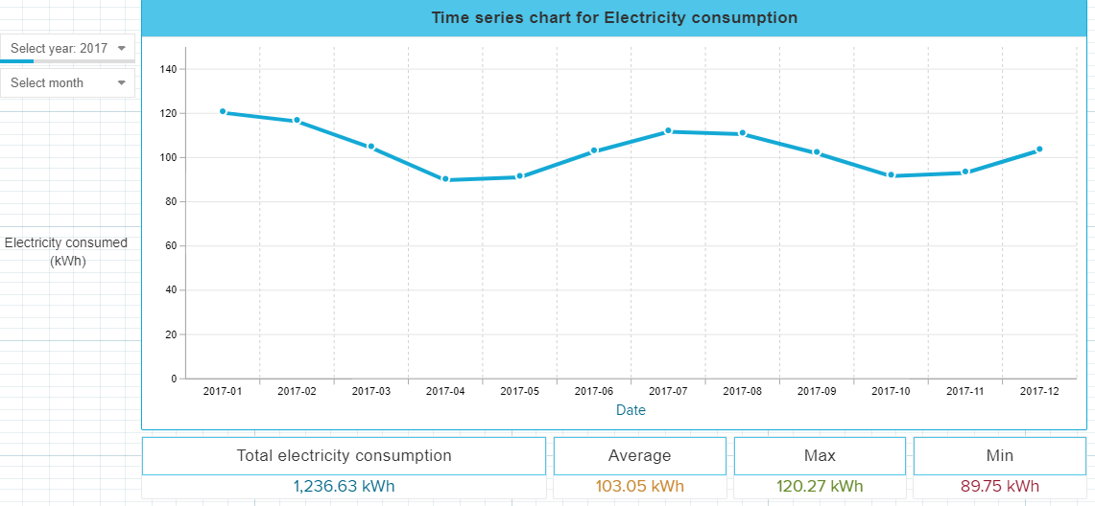
Requirement elicitation : Creating a time-series dashboard
An Electricity consumption analysis dashboard was created in Celonis snap application.
The data set used was Electricity consumption time series KPI data
( 1st January 2017 to 1st August 2020 ).
03694397, Siddhesh Kandarkar, Computer Assisted Natural Language Description of Trends and Patterns in Time Series Data

Slide 20
Requirement elicitation : Conducting task-based interviews
Formal interviews were conducted with expert and non-expert stakeholders in writing executive summary reports.
Interviewees were provided following tasks based on the time-series dashboard:
  Write a textual summary for Electricity consumption in the year 2017.
  Compare Electricity consumption in 2017 and 2018. Write a textual summary for the same.
  Write a textual summary on unique/contrasting data observations for the entire time period (1st January 2017 to 1st August 2020).
A set of questions for individual tasks were asked to the interviewees.
The main objective was to find out difficulties faced while manually writing textual executive summaries.
03694397, Siddhesh Kandarkar, Computer Assisted Natural Language Description of Trends and Patterns in Time Series Data

Slide 21
Requirement elicitation : Conducting task-based interviews
Following questions were asked to the interviewees for each task:
  Which part was more time consuming - data interpretation, deciding on what to write, or composing textual executive summary for the given task?
  What was more challenging– interpreting the data or writing a textual executive summary for the given task?
  How easy or difficult it was to decide what to include/exclude in the textual executive summary?
  How easy or difficult it was to decide how to organize the content of the textual executive summary?
  Suggestions to improve the current process of manual report writing.
  How could a software assist you in improving the process of report writing?
  How could a software assist you in making the process of report writing more efficient?
03694397, Siddhesh Kandarkar, Computer Assisted Natural Language Description of Trends and Patterns in Time Series Data

Slide 22
Requirement elicitation : Conducting task-based interviews
Following are the observations and participants feedback from task-based interviews:
Average time taken to write executive summaries for all the tasks was 15 minutes.
Problem statement and tasks were easy to understand.
Time-series KPI data set and time-series line chart was easy to interpret.
Writing a textual executive summary was more challenging than interpreting the data.
Deciding what to include and exclude in the textual summary and organizing that content of the textual summary was challenging.
Automation can improve the overall process of writing textual executive summaries.
03694397, Siddhesh Kandarkar, Computer Assisted Natural Language Description of Trends and Patterns in Time Series Data

Slide 23
Outline
Motivation and problem
Research questions and approaches
Different approaches for writing executive summaries for time-series data
Requirement elicitation
Prototype implementation and evaluation
Limitations and Future work
Conclusion
03694397, Siddhesh Kandarkar, Computer Assisted Natural Language Description of Trends and Patterns in Time Series Data

Slide 24
Prototype implementation
Time-series line chart and statistical data
RepGen
Time-series KPI data
Data expert
Data-driven report
Business stakeholders
Textual executive summary
03694397, Siddhesh Kandarkar, Computer Assisted Natural Language Description of Trends and Patterns in Time Series Data

Slide 25
Prototype implementation
We propose RepGen - a prototype for automated generation of textual executive summaries for time-series data.
RepGen is a single page application that adheres to our thesis objective and stakeholder requirements.
It is developed in Dash, a python framework for building interactive analytical applications. It is built on top of Plotly.js, React and Flask.
03694397, Siddhesh Kandarkar, Computer Assisted Natural Language Description of Trends and Patterns in Time Series Data

Slide 26
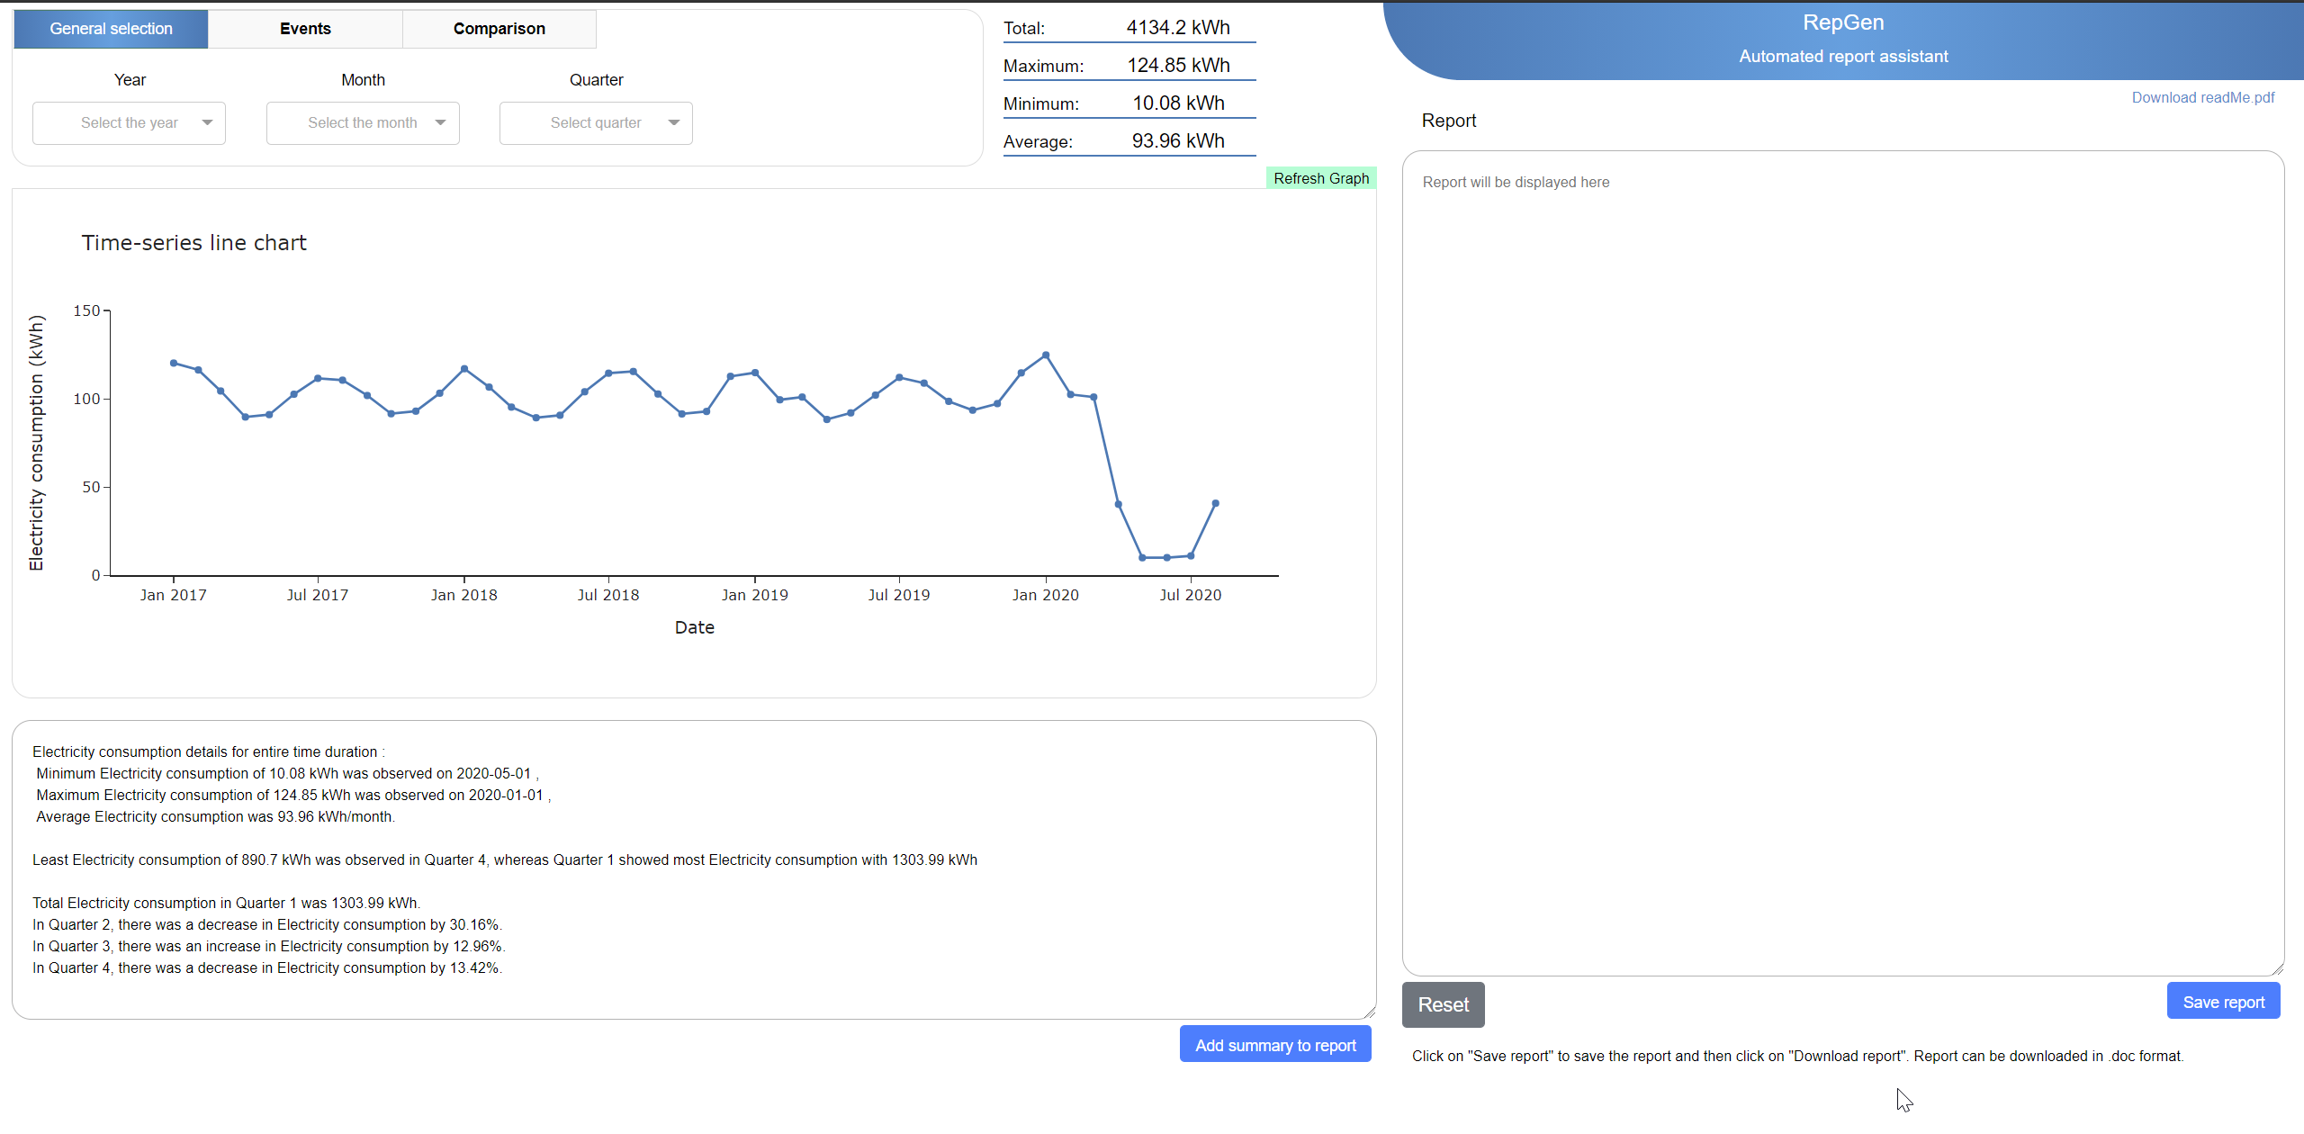
Prototype implementation
03694397, Siddhesh Kandarkar, Computer Assisted Natural Language Description of Trends and Patterns in Time Series Data

Slide 27
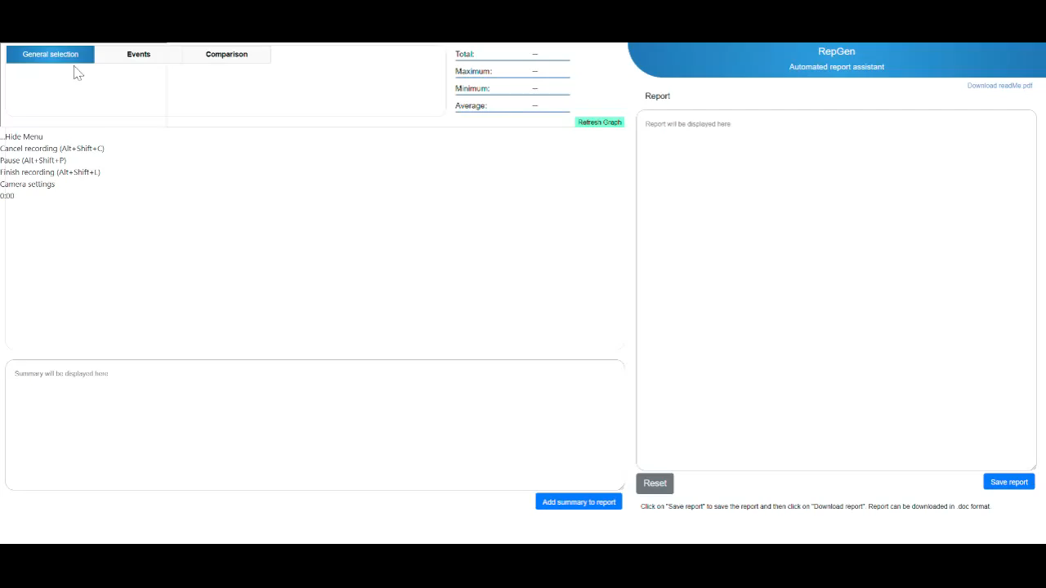
Prototype implementation
03694397, Siddhesh Kandarkar, Computer Assisted Natural Language Description of Trends and Patterns in Time Series Data

Slide 28
Prototype evaluation
NLG evaluation techniques:
Intrinsic evaluation
  Human evaluation / Human rating - subjects are asked to rate the text generated by NLG systems based on different metrics like fluency, accuracy, diversity etc.
  Corpus-based evaluation - Text generated by the NLG system is compared to the corpus text using automated metrics like BLUE and ROGUE.
2. Extrinsic evaluation
- This is a task-based evaluation technique.
- The participant is provided with text generated by the NLG system, and then the effectiveness of the system is measured on how well the generated text helped the participant to perform a given task.
03694397, Siddhesh Kandarkar, Computer Assisted Natural Language Description of Trends and Patterns in Time Series Data

Slide 29
Prototype evaluation – contd.
Human-based evaluation
To carry out a human-based evaluation on our prototype, an online survey was conducted, and the participants were asked to answer a short questionnaire.
We also provided online access to our prototype - RepGen and asked the participants to use the application and provide feedback accordingly.
To make the process easier for evaluation, we used the same Electricity consumption data set in the prototype, which was used during task-based interviews.
Evaluation metrics:
Intuitiveness
Quality
Accuracy
Fluency
03694397, Siddhesh Kandarkar, Computer Assisted Natural Language Description of Trends and Patterns in Time Series Data

Slide 30
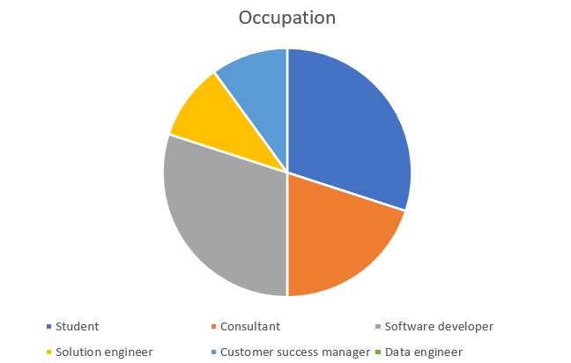
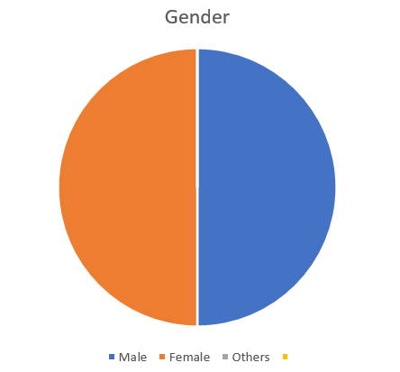
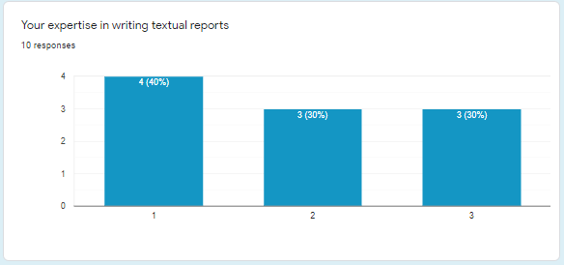
Prototype evaluation – contd.
Observation
Diversity among participants
In terms of expertise level
( 1 = non-expert, 2 = medium, 3 = expert)
In terms of Gender
In terms of Occupation
03694397, Siddhesh Kandarkar, Computer Assisted Natural Language Description of Trends and Patterns in Time Series Data

Slide 31
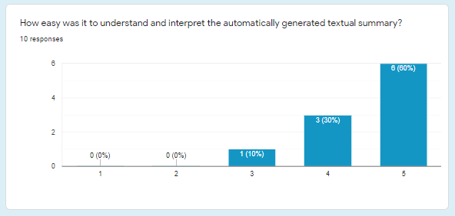
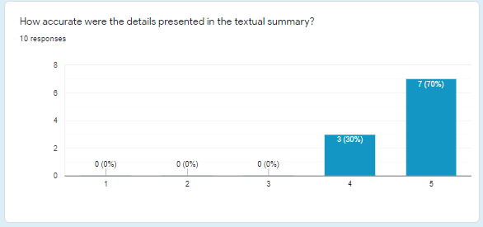
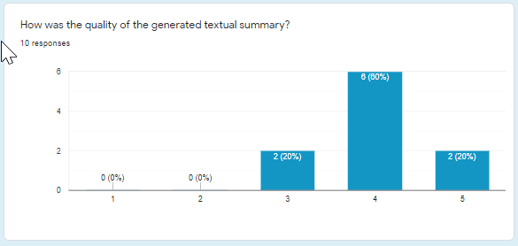

Prototype evaluation – contd.
Rating – These are the ratings given by interviewees for online survey conducted for RepGen
( 1 = worst , 5 = best)
Intuitiveness
Accuracy
Quality
Fluency
03694397, Siddhesh Kandarkar, Computer Assisted Natural Language Description of Trends and Patterns in Time Series Data
Notes:
.

Slide 32
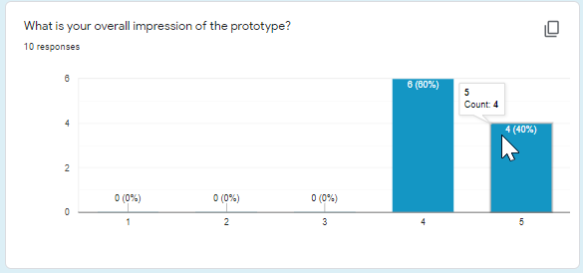
Prototype evaluation – contd.
Rating for overall impression of the prototype ( 1 = worst , 5 = excellent)
The average rating for this question was 4.4, with 40% rating 5,and 60% rating 4 on the Likert scale.
Overall impression
03694397, Siddhesh Kandarkar, Computer Assisted Natural Language Description of Trends and Patterns in Time Series Data

Slide 33
Findings – RQ3
RQ3 - Can an automated reporting assistant tool prove beneficial for the data experts in writing textual executive summaries for time-series KPI data?
  Used human-based evaluation techniques for evaluating the prototype
  Online survey was conducted, and participants were provided access to the prototype and asked to provide ratings.
  Rating for overall impression of the prototype ( 1 = worst , 5 = excellent)
  The average rating for this question was 4.4, with 40% rating 5,and 60% rating 4 on the Likert scale.
03694397, Siddhesh Kandarkar, Computer Assisted Natural Language Description of Trends and Patterns in Time Series Data

Slide 34
Outline
Motivation and problem
Research questions and approaches
Different approaches for writing executive summaries for time-series data
Requirement elicitation
Prototype implementation and evaluation
Limitations and Future work
Conclusion
03694397, Siddhesh Kandarkar, Computer Assisted Natural Language Description of Trends and Patterns in Time Series Data

Slide 35
Limitations and Future work
Limitations:
Limited number of task-based interviews
No Linguistic realisation engine
Output only in English language
Single output text for every input
Difficult to implement for complex datasets
Future work:
Linguistic Realisation engine
Multiple output options
Output in multiple languages
Hybrid approach
Improved trends and pattern detection
03694397, Siddhesh Kandarkar, Computer Assisted Natural Language Description of Trends and Patterns in Time Series Data

Slide 36
Outline
Motivation and problem
Research questions and approaches
Different approaches for writing executive summaries for time-series data
Requirement elicitation
Prototype implementation and evaluation
Limitations and Future work
Conclusion
03694397, Siddhesh Kandarkar, Computer Assisted Natural Language Description of Trends and Patterns in Time Series Data

Slide 37
Conclusion
03694397, Siddhesh Kandarkar, Computer Assisted Natural Language Description of Trends and Patterns in Time Series Data

Slide 38
Questions
03694397, Siddhesh Kandarkar, Computer Assisted Natural Language Description of Trends and Patterns in Time Series Data

Slide 39
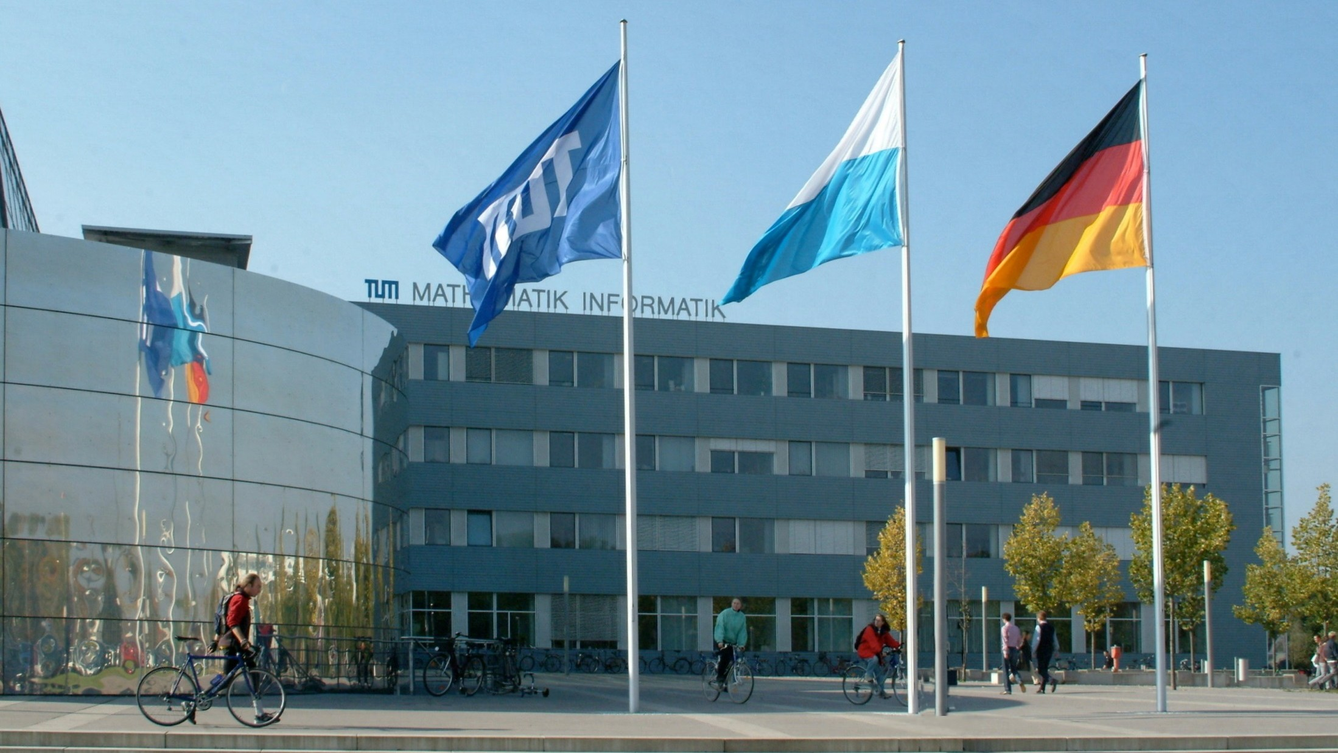



B.E.
Siddhesh Kandarkar
Technische Universität München Faculty of Informatics
Chair of Software Engineering for Business Information Systems
Boltzmannstraße 3
85748 Garching bei München
Tel +49.89.289. 17132
Fax +49.89.289.17136
matthes@in.tum.de wwwmatthes.in.tum.de

